Slide 1

Mohammad Yawar Bhat

Slide 2
Methodology:
Create a
Structure
Meshing of the
structure
Run Electrostatic simulations on
EDR_CAD
Analyze and plotting the Result on
Matlab
1. We begin by creating the structure of the device.
2. Next, we perform meshing on this structure.
3. Using the meshing file and an input file, we run an electrostatic simulation on the EDR_CAD simulator.
4. This simulation produces different electrostatic files for various gate voltages.
5. Finally, we plot and analyze these electrostatic files in MATLAB.

Slide 3
Structure MoS2 TFET :
Cutline for below
Electrostatic plots
Gate Contact
Source
contact
Drain Contact
HfO2
Thickness = 30nm
+
MoS2
Thickness = 5nm
Net Doping = 2 X 10²² m⁻³
HfO₂
MoS₂
SiO₂_2
+
C C_{X}
(0,0,0)
SiO2_2
Thickness = 14nm
Fixed bulk charge density= 10²⁴ m⁻³
C_{Y}
+
SiO2
C_{X} =550 nm
C_{Y} =135 nm
SiO₂
Notes:
Cut line

Slide 4
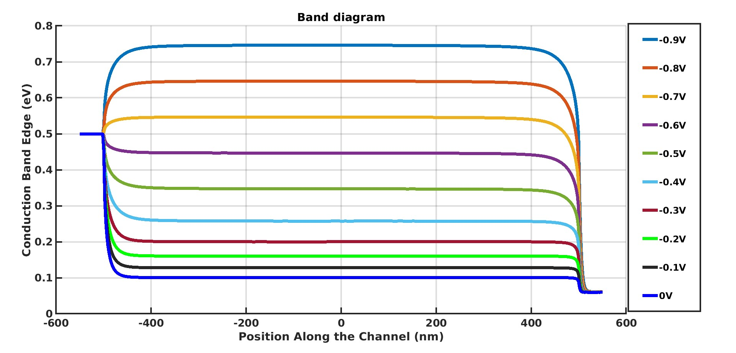
Actual device
Channel length (L_{ch}) =1micrometer
MoS2 under
contacts
MoS₂ under
Top Gate
MoS2 under
contacts
G .A Gauhar et. al, Adv theory simul.2024,2400202
Shubhadeep Bhattacharjee wt. al, Appl. Phys. Lett. 111, 163501 (2017)

Slide 5
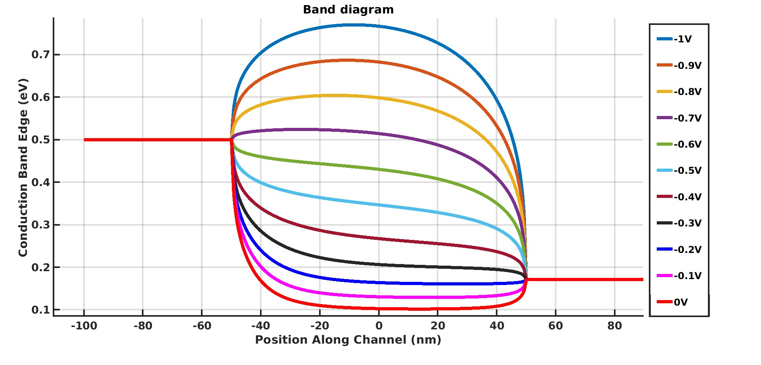
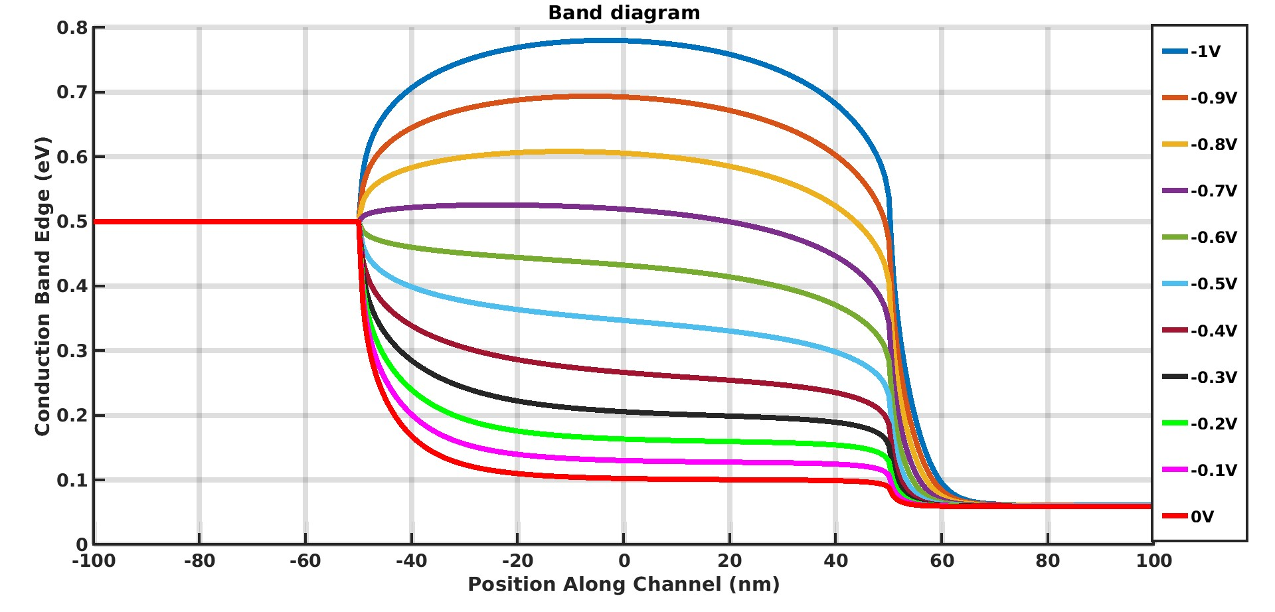
Length of channel(L_{ch})= 100nm
Fixed Drain voltage (V_{d})
Length of channel(L_{ch})= 100nm
Von Neuman Boundary conditions
MoS2 under
contacts
MoS2 under
Top Gate
MoS2 under
contacts
MoS2 under
contacts
MoS2 under
Top Gate
MoS2 under
contacts

Slide 6
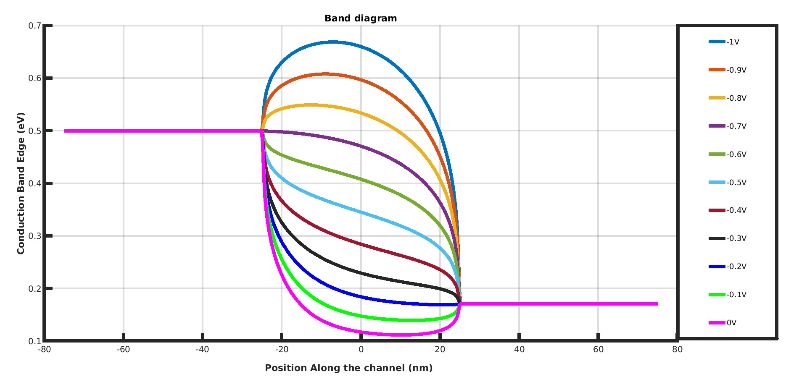
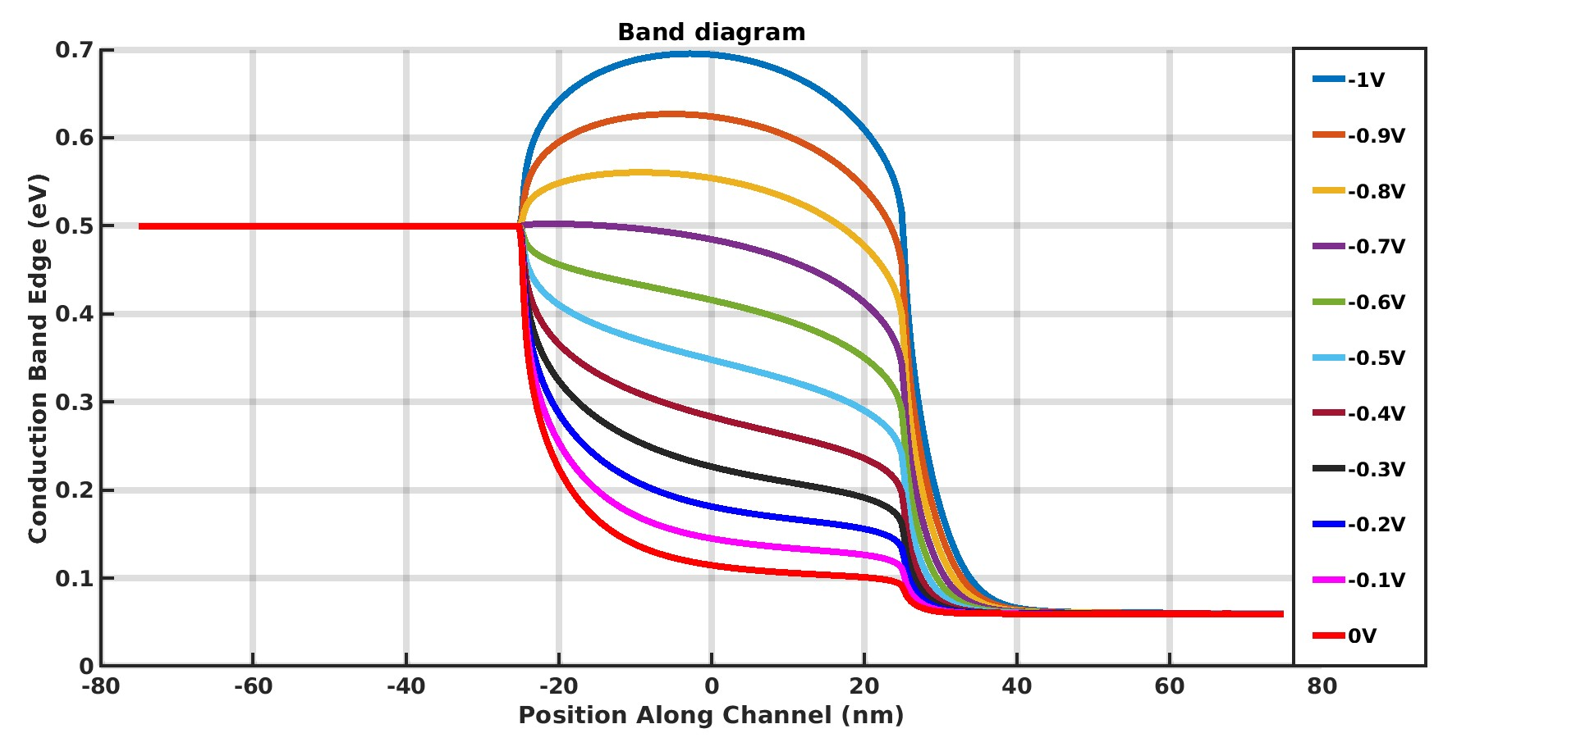
Length of channel(L_{ch})= 50nm
Fixed Drain voltage (V_{d})
Length of channel(L_{ch})= 50nm
Von Neuman Boundary conditions
MoS2 under
contacts
MoS2 under
Top Gate
MoS2 under
contacts
MoS2 under
contacts
MoS2 under
Top Gate
MoS2 under
contacts

Slide 7
Optimised Electrostatic Potential With Different Doping And Channel Length

Slide 8
Doping (cm³ ) | V_{tg} (Volt) ( For ϕ = 0.35ev) | Channel Length(nm)
2x10¹⁶ | -1 | 300
2x10¹⁸ | -1.3 | 400
2x10¹⁹ | -3.85 | 400
Case 1
Case 2
Case 3

Slide 9
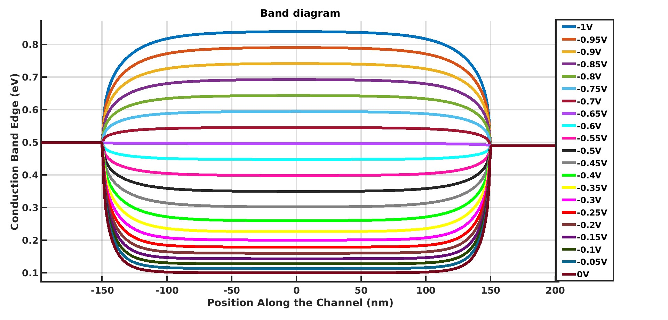
CASE 1:
For Raw Data: https://docs.google.com/spreadsheets/d/10P8Wx67FCJiKRy0RdKTZZni4301Csgvp/edit?usp=drive_link&ouid=109772339849498475965&rtpof=true&sd=true

Slide 10
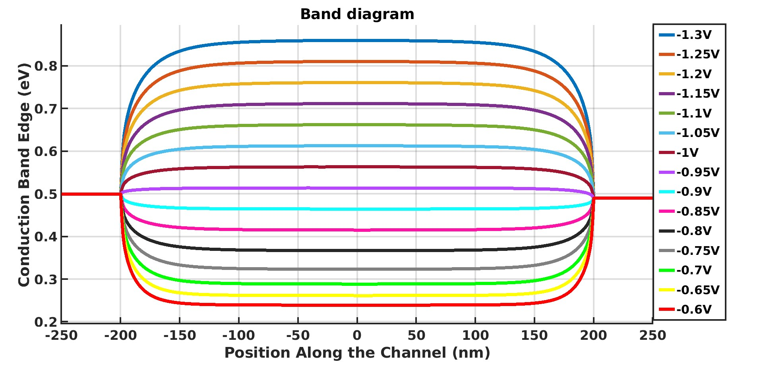
CASE 2:
For Raw Data: https://docs.google.com/spreadsheets/d/1JL88ehWRUMr7-SiHTUlPqRQVQ9CTaoJ8/edit?usp=drive_link&ouid=109772339849498475965&rtpof=true&sd=true

Slide 11
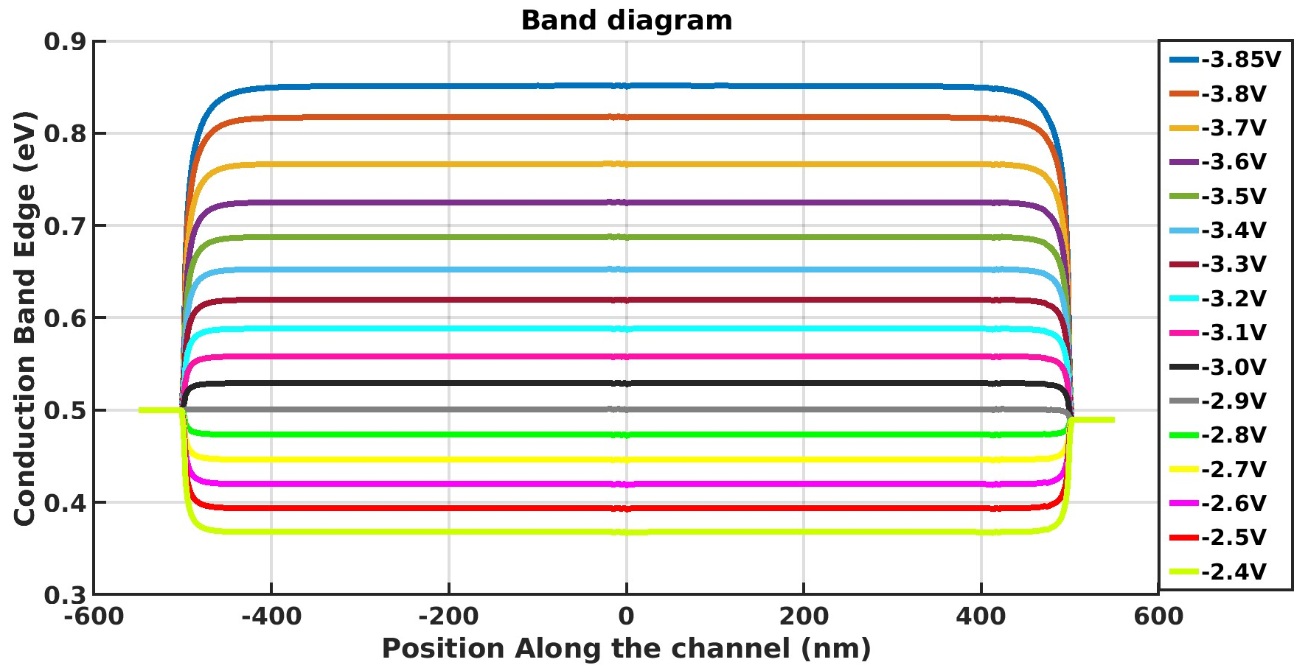
CASE 3:
Raw data : https://docs.google.com/spreadsheets/d/17J6ao2uxUeGHkzL7eS83cQ-xXOtemoPb/edit?usp=drive_link&ouid=109772339849498475965&rtpof=true&sd=true

Slide 12
Summary
CASE 1:
CASE 2:
CASE 3:

